Slide 1

DriftO
Spontaneous Adventure Generator
Mood-based discovery for spontaneous travelers.

Slide 2

Pain Points
Rigid, Over-Planned Trips
Let's face it, meticulously planned itineraries can feel like a gilded cage. Every second accounted for, no room for the unexpected, and a constant pressure to stick to the schedule. Where's the fun in that? We aim to break free from the tyranny of the travel spreadsheet.
Wasted Time, Zero Inspiration
Scrolling endlessly through travel blogs, review sites, and generic "top 10" lists? Hours melt away, and you're still stuck in the same rut. The quest for that spark of travel inspiration often ends in frustrating paralysis.

Slide 3

Vibeway: Your Spontaneity Sidekick
Fun
Fast
Infuse your getaways with a sense of playfulness and excitement. Vibeway unlocks experiences you won't find on typical tourist trails.
Ditch the endless planning. In a matter of taps, Vibeway delivers a curated destination and itinerary tailored to your whim.
Mood-Driven
Travel that aligns with how you *feel*. Select a vibe, and let Vibeway conjure up adventures that match your desired emotional state.
With Vibeway, spontaneous travel is no longer a fantasy – it's an effortless reality. We transform the overwhelming task of trip planning into an instant doorway to unique experiences.

Slide 4
Primary Research
Through in-depth interviews and surveys with a diverse group of travelers, we uncovered critical insights into their planning habits, motivations, and pain points. Our findings validate the need for a solution that empowers spontaneous and fulfilling adventures.
The Search for Spontaneity
Two Distinct Traveler Profiles
The Discovery Dilemma
Many travelers express a strong desire for more spontaneous trips, but often find themselves overwhelmed by the sheer volume of choices and the complexity of last-minute planning.
Our research revealed two primary user segments: the "Spontaneous Explorers" who embrace last-minute decisions, and the "Meticulous Planners" who prefer detailed itineraries. Vibeway is designed to cater to the former, while also offering appeal to the latter for certain trip types.
Users struggle with discovering unique, authentic experiences outside of mainstream tourist attractions. They seek inspiration that truly aligns with their mood and current desires, not just generic recommendations.

Slide 5
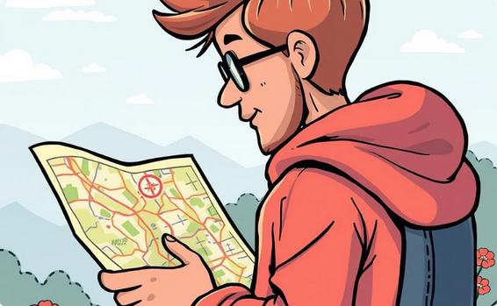
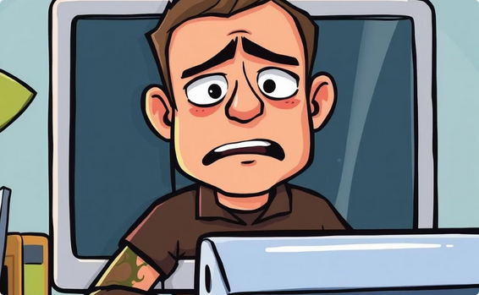


Our Survey Questions
Following our primary research, we designed a comprehensive set of survey questions to gather detailed insights into traveler preferences, pain points, and desires regarding spontaneous adventures. These questions helped us validate our assumptions and refine the core features of Vibeway.
How often do you typically engage in spontaneous, unplanned travel?
What are the biggest obstacles you face when trying to plan a last-minute trip?
What kind of experiences (e.g., relaxing, adventurous, cultural) do you seek on a trip?
How important is it for you to have a trip that matches your current mood or "vibe"?

Slide 6
Survey Insights
Our comprehensive survey allowed us to quantify the qualitative findings from our interviews, providing further validation for Vibeway's core value proposition. Key takeaways from the survey responses confirmed several critical points:
Desire for Spontaneity is High
The "Vibe Match" Matters
A significant portion of respondents expressed a strong desire for more spontaneous travel, but often cited "lack of time for planning" and "overwhelm with choices" as major inhibitors.
Respondents overwhelmingly prioritized experiences that align with their desired mood or "vibe," indicating a clear need for mood-based recommendations over generic travel suggestions.
Discovery of Unique Experiences
Demand for Efficiency
Many travelers struggle to find unique, non-touristy experiences, confirming the "discovery dilemma" identified in our initial research. They seek curated, authentic options.
The survey reinforced that travelers value efficiency in planning, especially for last-minute trips. They are looking for a solution that significantly reduces the friction of spontaneous adventures.
These insights collectively underscore the market need for Vibeway as a solution that simplifies spontaneous travel and connects users with experiences that genuinely match their current emotional state.

Slide 7






Competitor Analysis
Thorough analysis of existing travel apps and services.
Examination of platforms offering spontaneity or curated experiences.
Identified key players, their strengths and weaknesses.
Pinpointed unmet user needs for Vibeway to address.
Refined Vibeway's unique value proposition to stand out.
Positioned Vibeway to uniquely serve the spontaneous traveler.

Slide 8




Empathy Map
Says
Thinks
"I wish I could travel more spontaneously, but planning is a headache."
There has to be an easier way to find last-minute adventures.
"I'm tired of tourist traps; I want authentic, unique experiences."
Is this trip going to feel right for my current 'vibe'?
"Just tell me where to go based on my mood right now."
I want discovery, not just a checklist of sights.
Feels
Does
Excited by the idea of unexpected journeys.
Scrolls endlessly through social media for travel inspiration.
Frustrated by the overwhelming number of choices and planning time.
Often cancels spontaneous plans due to planning friction.
Joyful when an experience perfectly matches their desired mood.
Asks friends for recommendations for unique local spots.
Overwhelmed by traditional travel booking sites.
Tries to book last-minute, but often gives up.

Slide 9

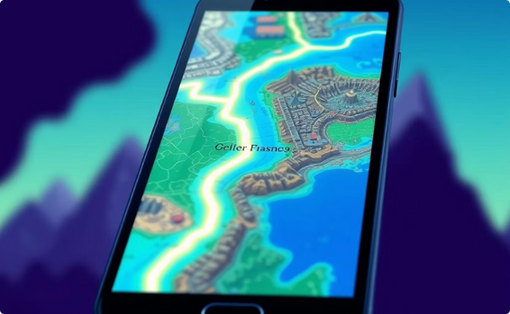




Storyboard
Feeling stuck? Alex dreams of escape from the everyday routine.
Vibeway suggests a magical, unexpected path to discovery.
An impulsive decision leads to a wondrous, serene journey.
Discovering a quirky, off-the-beaten-path local gem.
Immersing themselves in an authentic, joyful experience.
Returning home refreshed, with memories of a perfect day.

Slide 10

Persona
"I follow my mood, not a map. I just want to escape, feel something, and discover places that match me."
Bio
Alex is a 28-year-old student with a restless spirit and a craving for emotional freedom. She’s always looking for something refreshing a quiet café, a walkable sunset point, or a hidden art corner. Rhea doesn’t plan her days in advance; she lets her mood guide her movement.
Coping Style
Journals or scrolls music playlists when bored
Looks for emotional “escape windows” (walks, tea, music)
Uses social media to spot hidden hangout inspiration
Sometimes just sleeps through the boredom
Alex
28 yrs
Goals
Escape routine without overplanning
Discover low-budget, emotionally fulfilling adventures
Share aesthetically pleasing, meaningful moments
Feel present and emotionally refreshed during downtime
Frustrations
Overwhelmed by too many choices on Google/Instagram
Finds travel planning mentally draining
Gets bored when she stays indoors too long
Tourist spots feel overhyped, underwhelming
Status: Single
Occupation: Graphic Designer
Activity: Anxiety Management
Location: Mumba, India
Tech Comfort: High
Preferred Wellness Tools
Mood journaling apps
Music apps (Spotify, Lofi channels)
DriftO (vibe-based place suggestion)
Soft adventure or movement
Triggers
Feeling stuck in one place
Friends canceling plans last minute
Seeing café/street reel on Instagram
Craving “me-time” without noise or pressure

Slide 11

Negative
Persona
"If it’s not planned, it’s not worth doing. I need structure, not surprises."
Bio
Patricia is a 45-year-old corporate project manager who thrives on organization, timelines, and full control over her surroundings. She treats travel like a well-executed operation, planning every stop, every break, and every check-in far in advance. Apps like DriftO, which offer spontaneous or mood-based suggestions, feel chaotic and impractical to her. She’s risk-averse, avoids uncertainty, and only chooses destinations that are reviewed, safe, and predictable.
Coping Style
Uses spreadsheets to plan everything
Researches hotels, transport, places weeks in advance
Relies heavily on TripAdvisor, MakeMyTrip, or Google Reviews
Doesn’t travel if plans are not “100% known”
Patricia
45 yrs
Goals
Maximize productivity, even in leisure time
Eliminate uncertainty from travel experiences
Follow fixed itineraries with full control over time and budget
Stick to trusted travel providers and sources
Frustrations
Dislikes spontaneous planning
Finds mood-based travel apps unstructured and "vague“
Avoids local or unknown spots due to safety concerns
Views emotional exploration as “waste of time”
Status: Married
Occupation: Project Manager
Activity: Itinerary Planning
Location: Delhi, India
Tech Comfort: Medium
Preferred Wellness Tools
Calendar apps (Google Calendar, Notion)
Travel blogs and TripAdvisor
Package tour planners
Physical journals or printed itineraries
Triggers
Unpredictable weather or delays
Apps suggesting “surprise” plans or unknown routes
No access to reviews, ratings, or safety information.

Slide 12





User Journey
Inspiration
User opens Vibeway, seeking a spontaneous escape from the mundane.
Mood Selection
Chooses a mood – "weird + fun," "quiet + pretty," or "cheap thrill" – reflecting their current desires.
Destination Reveal
Vibeway unveils a curated destination perfectly matched to their selected mood.
Hidden Gems
Discovers a selection of offbeat, local experiences unique to that destination.
Spontaneous Adventure
Embarks on an unforgettable, unplanned journey filled with unexpected delights.

Slide 13




Key Features
Mood Selector
A dynamic and intuitive interface that allows users to easily express their desired travel vibe through a curated selection of moods.
Hidden Gem Suggestions
Unearthing unique, off-the-beaten-path experiences that cater to the adventurous spirit and provide a deeper connection to the local culture.
Surprise Plans
Embrace the unknown with randomly generated itineraries and activities that push users outside their comfort zone and create memorable moments.

Slide 14
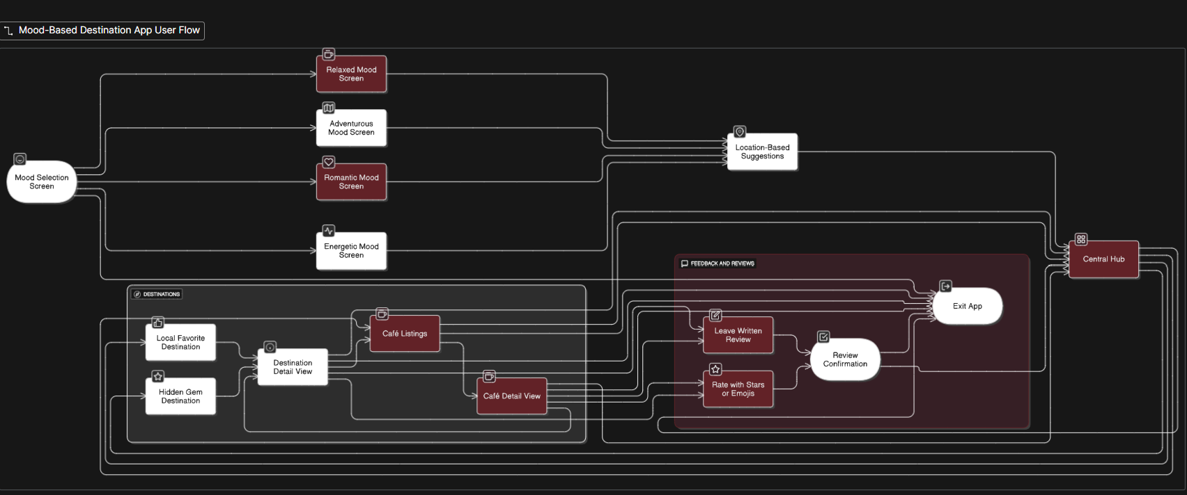
Information Architecture

Slide 15





Task Flow
App Opens
User launches Vibeway, seeking a quick escape or a new experience.
Select Preferences
User defines their desired travel vibe by choosing a mood, time, and budget.
Destination Suggestions
Vibeway generates unique destination ideas and activities based on the selected preferences.
Explore Location
The user delves into the suggested location, discovering hidden gems and local experiences.
Provide Feedback
After their adventure, the user can provide feedback to help improve future recommendations.

Slide 16

Figma Prototype:
https://www.figma.com/proto/uGPJazEZUJpYQFO0gsClBt/Untitled?node-id=0-1&t=YgFqA5mavSAV6tMJ-1

Slide 17
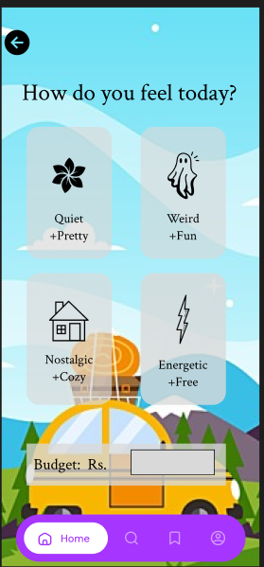
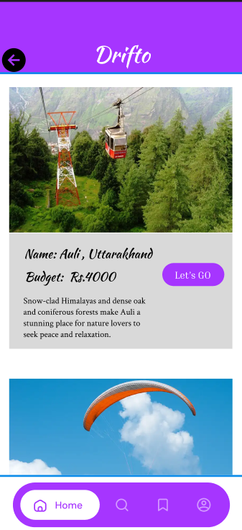
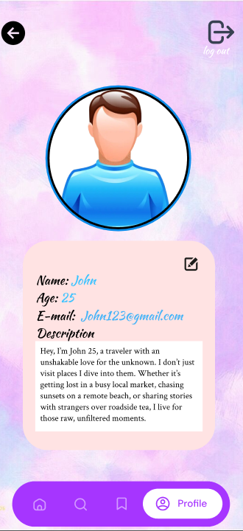
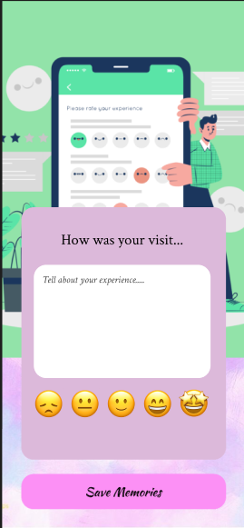
Mockups & Wireframes

Slide 18
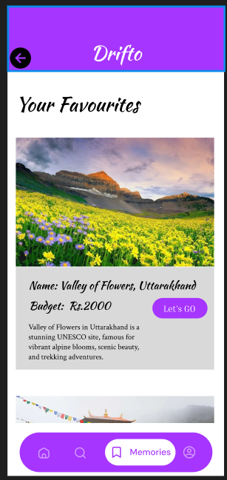
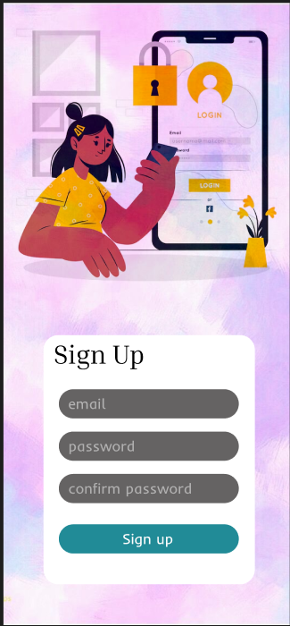
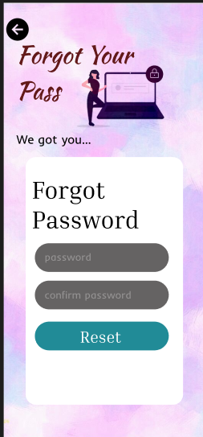
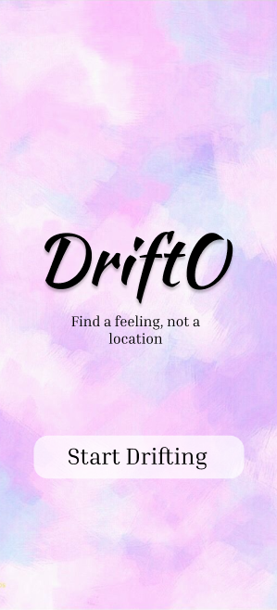
Mockups & Wireframes

Slide 19
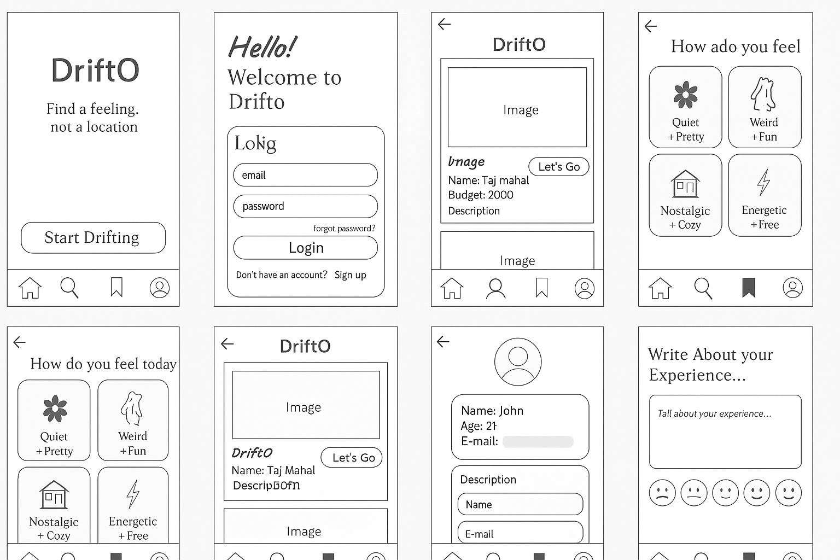
Mockups & Wireframes

Slide 20
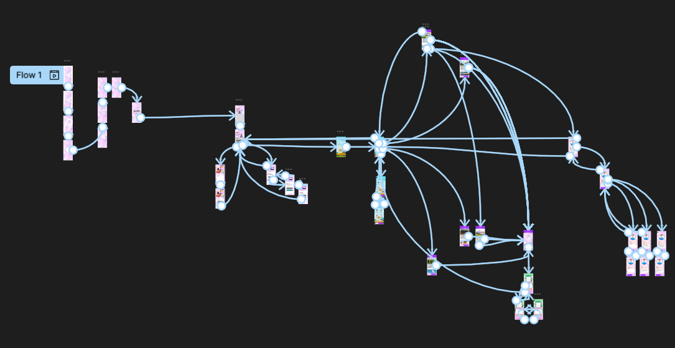

Slide 21

Thanks for tuning in to spontaneous adventures!
Embrace the unexpected and make every journey a story worth telling.

